Slide 1
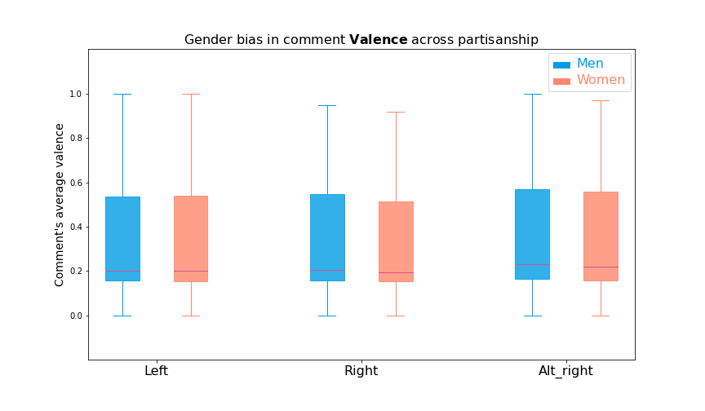
n.s.
p<.0001
.307
.305
.319
.293
.347
.332

Slide 2
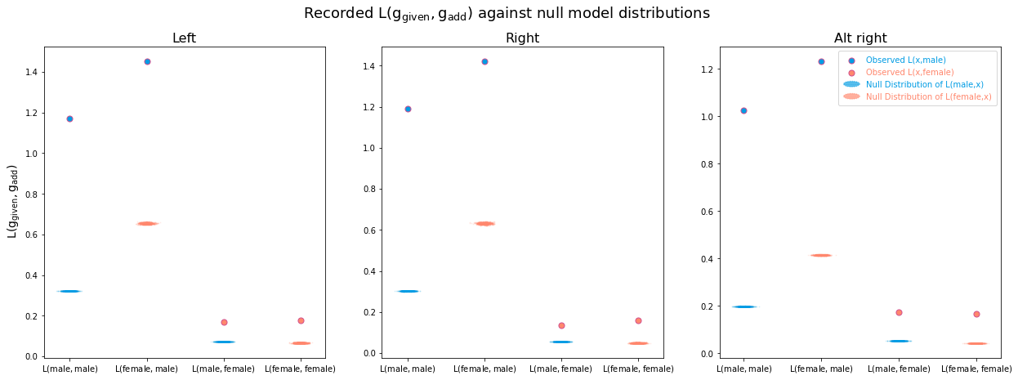
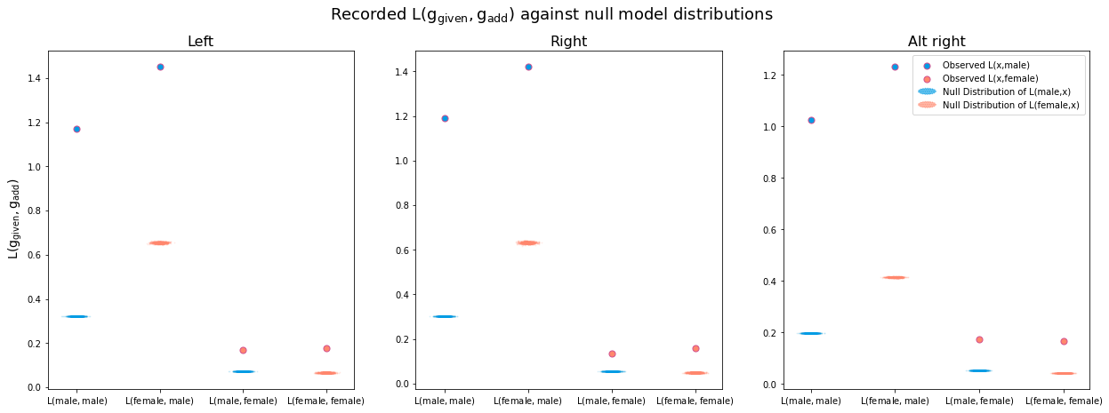
L(male, male)
L(female, male)
L(male, female)
L(female, female)
L(male, male)
L(female, male)
L(male, female)
L(female, female)
L(male, male)
L(female, male)
L(male, female)
L(female, female)

Slide 3
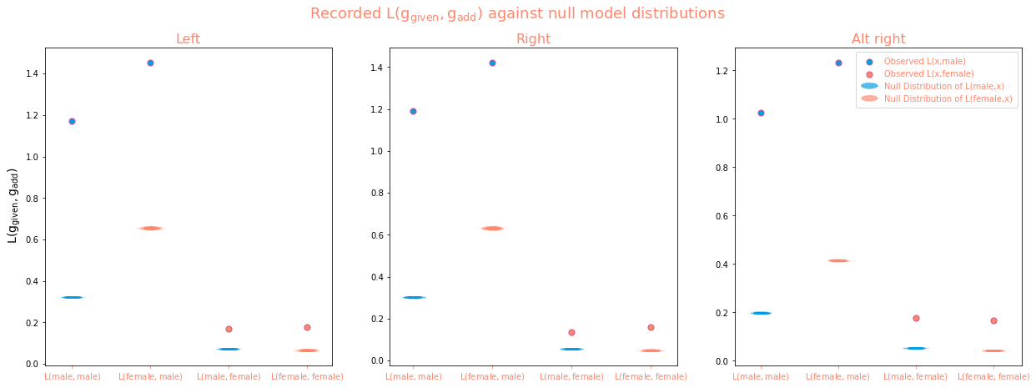

Slide 4
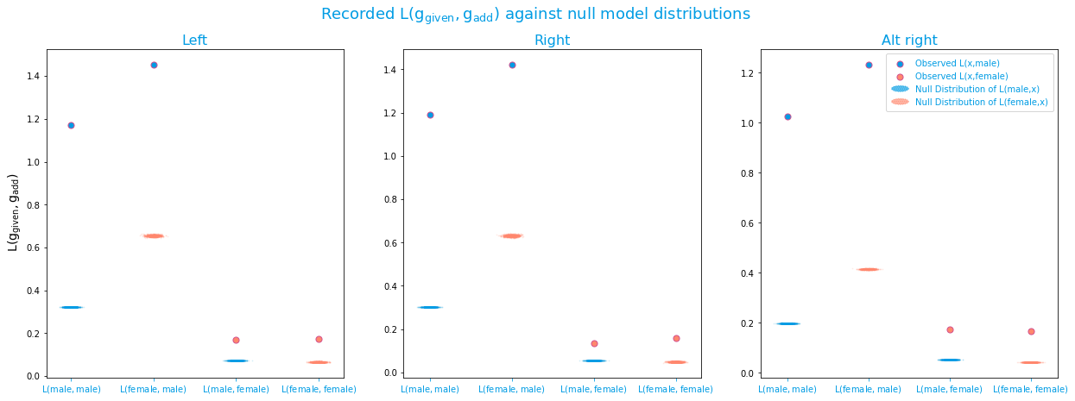

Slide 5
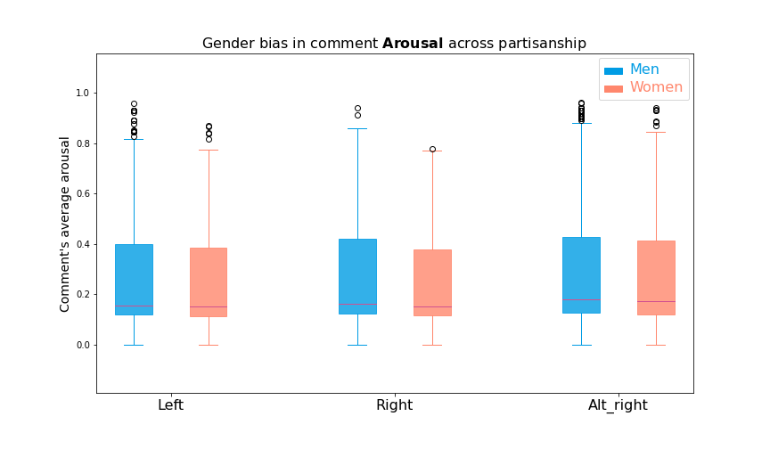
n.s.
p<.0001
.232
.226
.249
.223
.265
.252

Slide 6
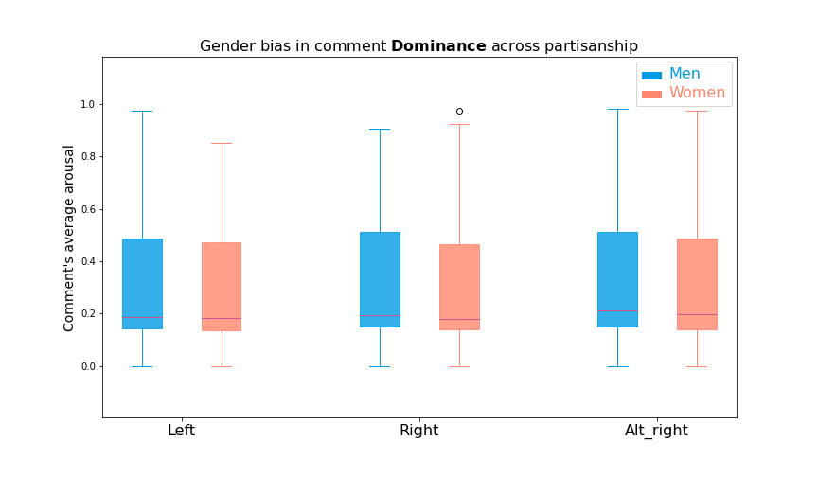
n.s.
p<.0001
.282
.274
.299
.268
.315
.296

